Slide 1
Module 2: Life Cycles and Navigation
SER 423

Slide 2
Concept of a Life Cycle

Slide 3
Defining a Life Cycle
The traditional definition of a program life cycle includes the development of that application. We are concerned only with the execution of the application.
Take a moment to think about the life cycle of a program built for regular desktops. Write down what you would consider the key steps in the life cycle of a program during runtime.

Slide 4
Key Lifecycle Steps
Your answers might look something like these:
Loaded into memory
Initialization
Main Loop
Clean Up

Slide 5
How These Steps Relate to Mobile Life Cycles
This general sequence of events still occurs for mobile apps
However, when we talk about life cycles in the context of mobile development we are usually referring to a different set of steps
There is a set of sub-steps that take place (usually during the Main Loop phase) that handle each individual view
It is these life cycles that we usually refer to when speaking about mobile apps
You can think of these almost as the life cycle of an individual thread
  To be clear, these are not specifically separate threads but the idea of a life cycle within the larger one can be applied here

Slide 6
Android Life Cycles

Slide 7
The Activity Life Cycle
“An activity is a single, focused thing that the user can do. Almost all activities interact with the user, so the Activity class takes care of creating a window for you in which you can place your UI with setContentView(View).” [1]
Activity and View sometimes get used interchangeably but that is not really correct
Activities are better understood as the Controller for a given View
The life cycle of an Activity is directly tied to how and where much of the logic is implemented
Since Activities are strongly tied to Views your app likely has several activities in it
Leveraging these will be important to moving between Views
https://developer.android.com/reference/android/app/Activity

Slide 8
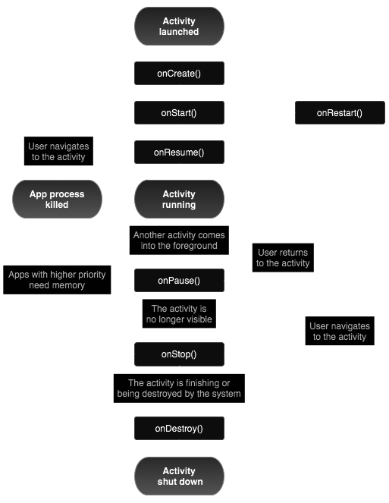
Diagram of an Activity Life Cycle
From: https://developer.android.com/guide/components/activities/activity-lifecycle

Slide 9
iOS Life Cycles

Slide 10
The UIApplication, App Delegate, and UIViewController
In iOS, the UIApplication object handles many of the high level app behaviors
This includes scheduling, to and from the foreground and background, and creation and destruction
In short, it manages the apps overall life cycle
App Delegate objects are the focus of initialization and state transitions
UIViewController is the base class for View Controllers and provides for loading and rotating Views
To compare back to Android, the UIViewController and App Delegate split the functionality of an Activity

Slide 11
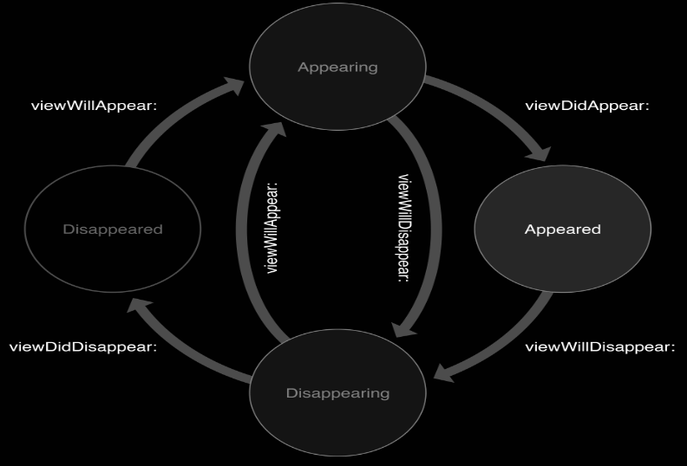
Diagram of View Controller Transitions

Slide 12
End of Android and iOS Life Cycles
Next time - Moving Between Views

